Slide 1

Designing Albuquerque: An Open House for Architects, Landscape Architects & Engineers
Projects
June 15, 2022

Slide 2

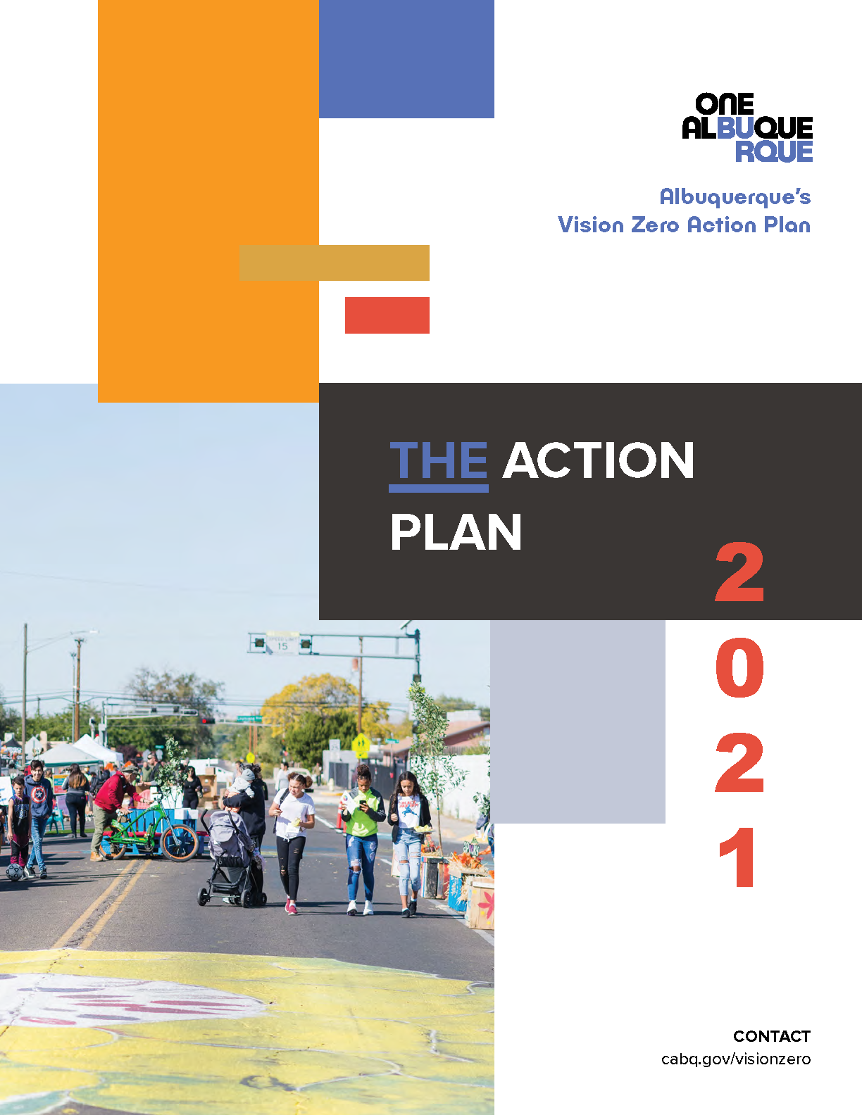

Slide 3
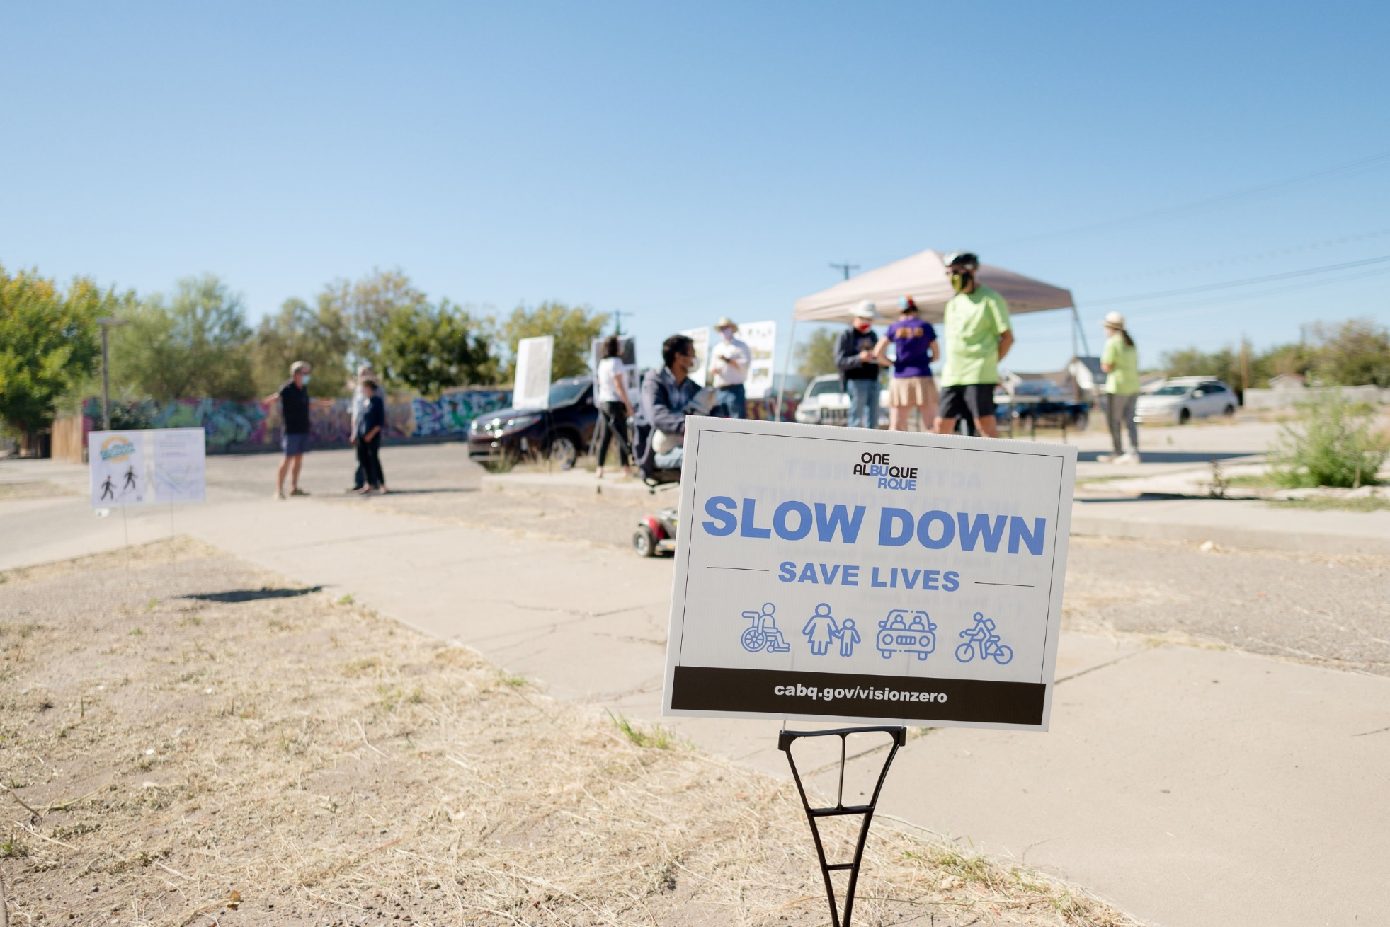
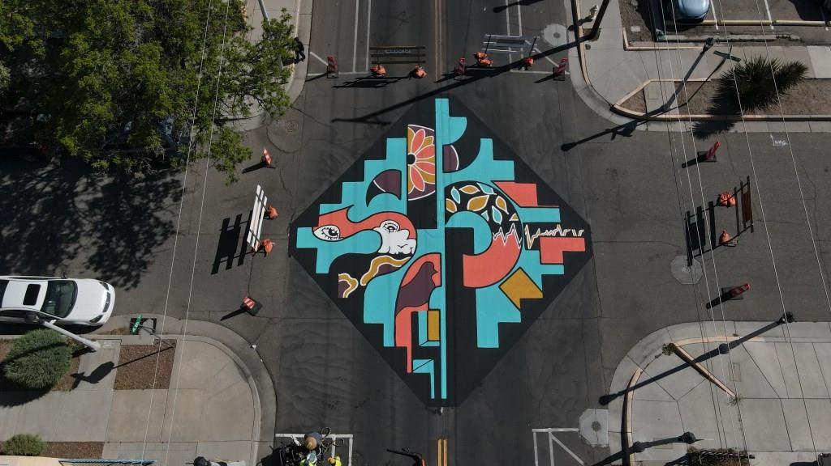

Slide 4
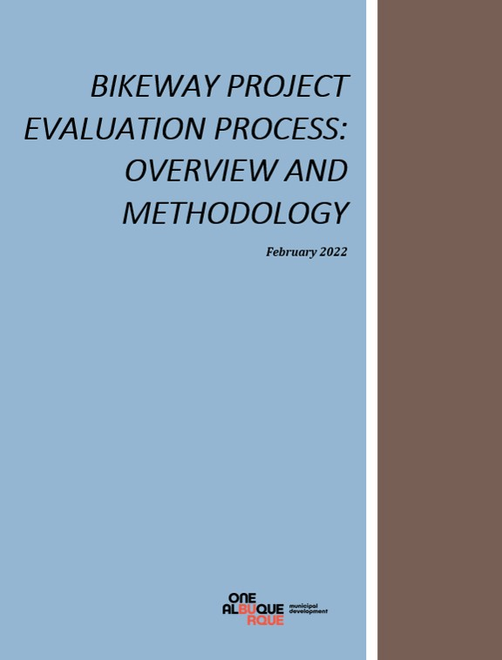


Slide 5

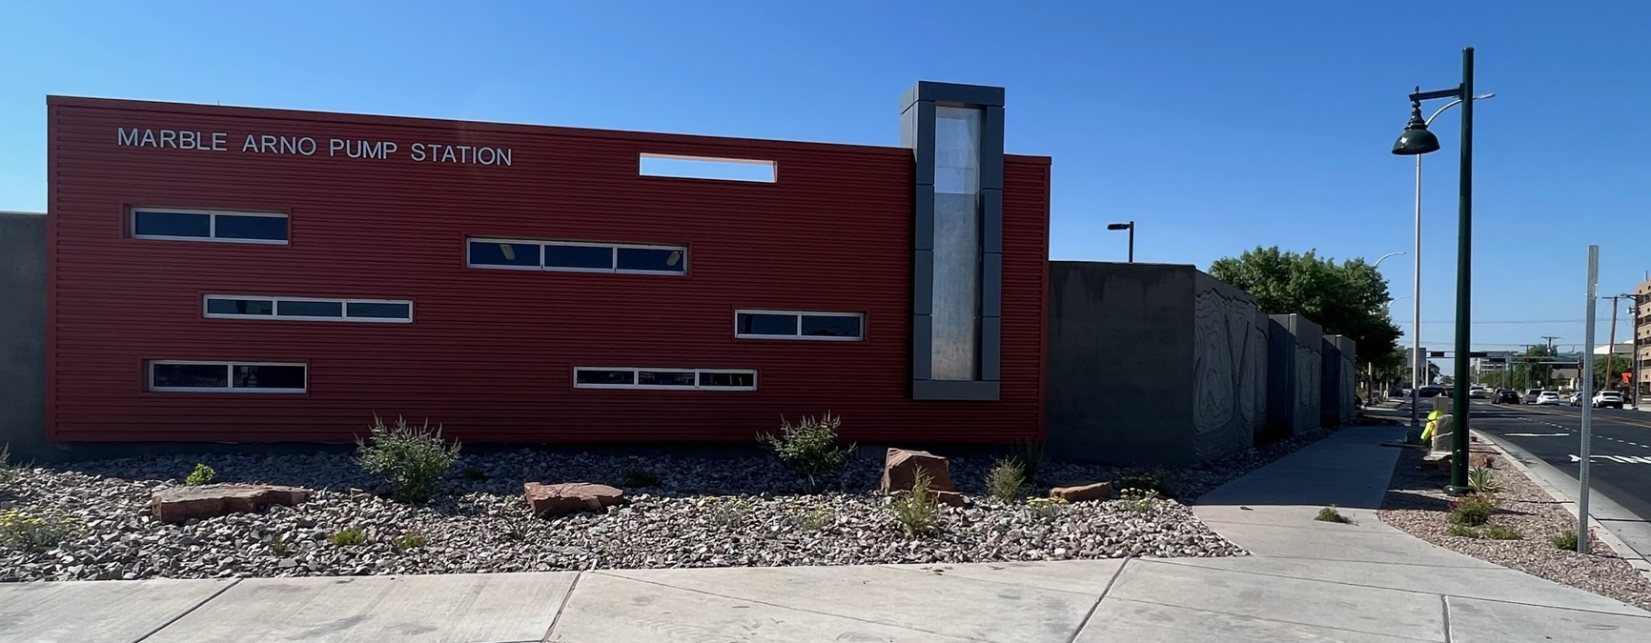
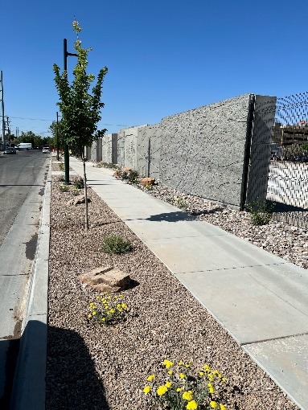
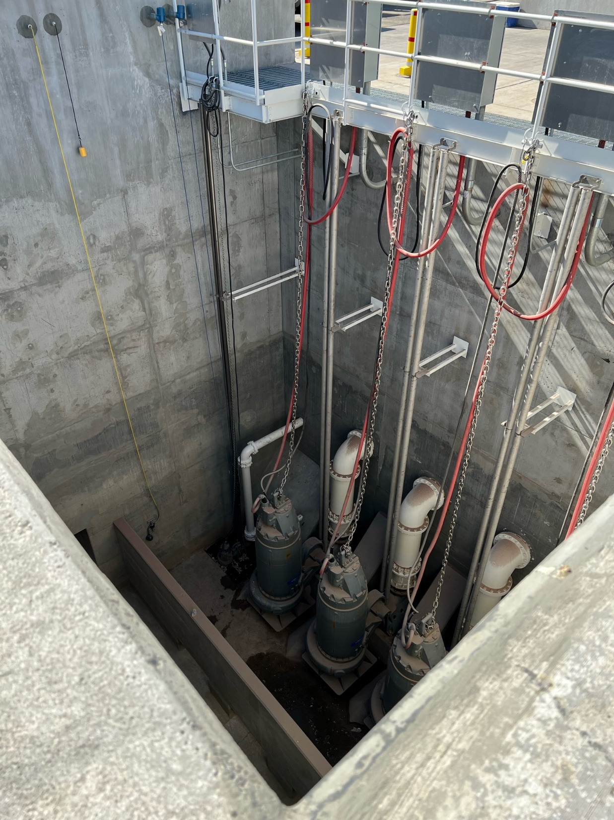
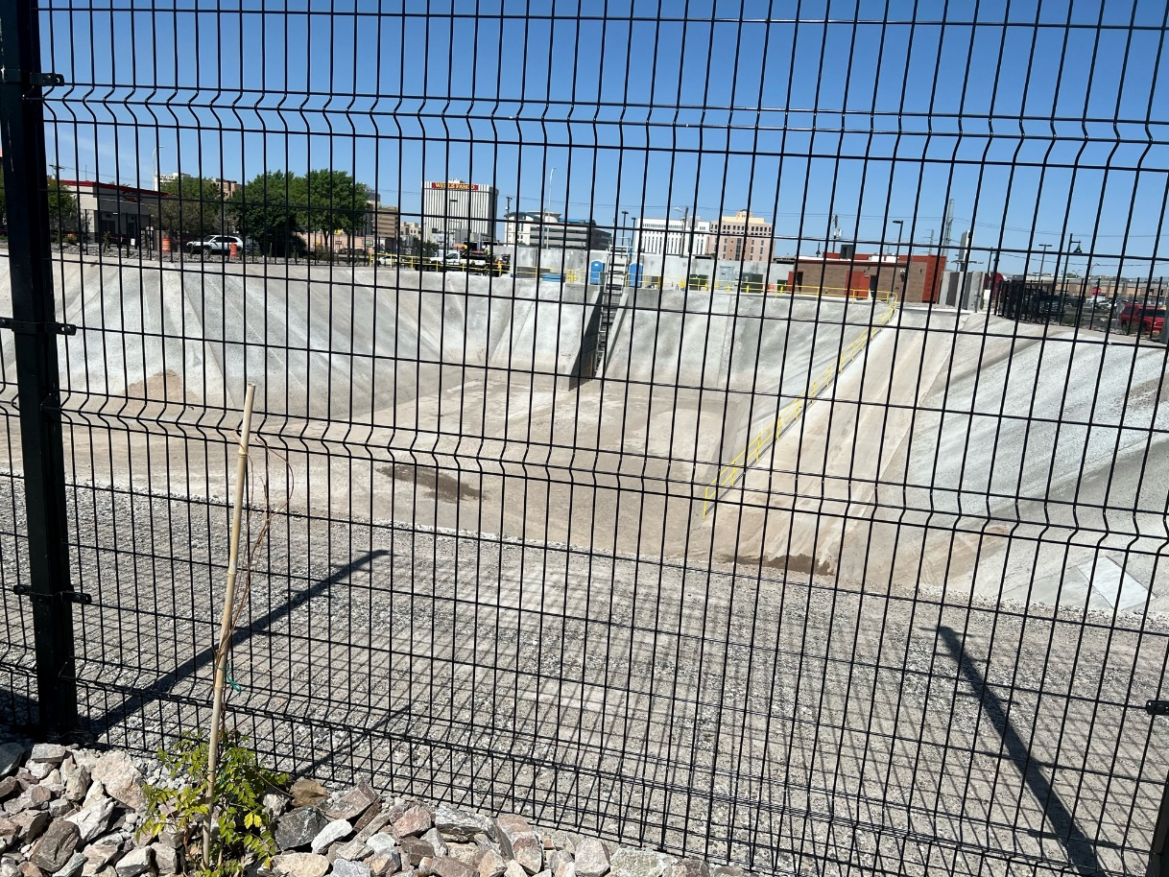
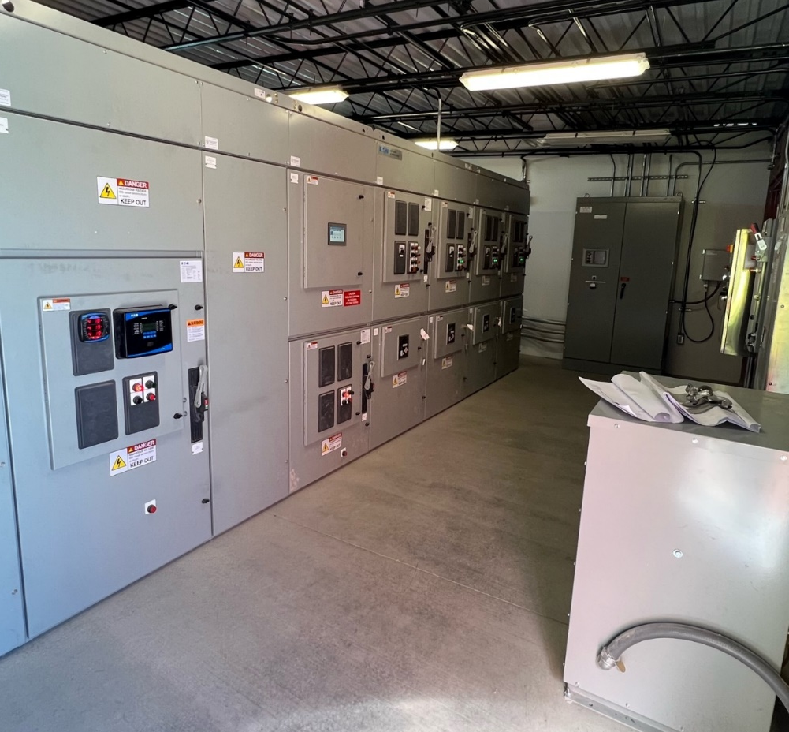
Marble/Arno Pump Station

Slide 6
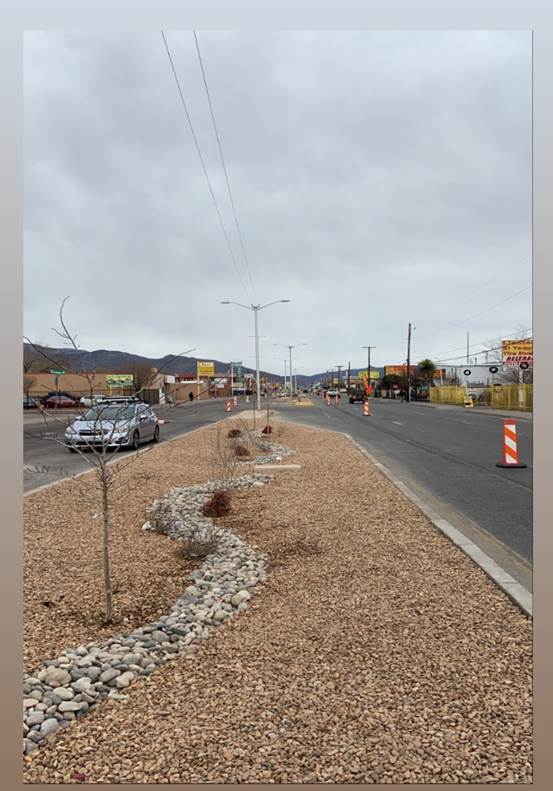
East Central Landscaping Improvements

Slide 7
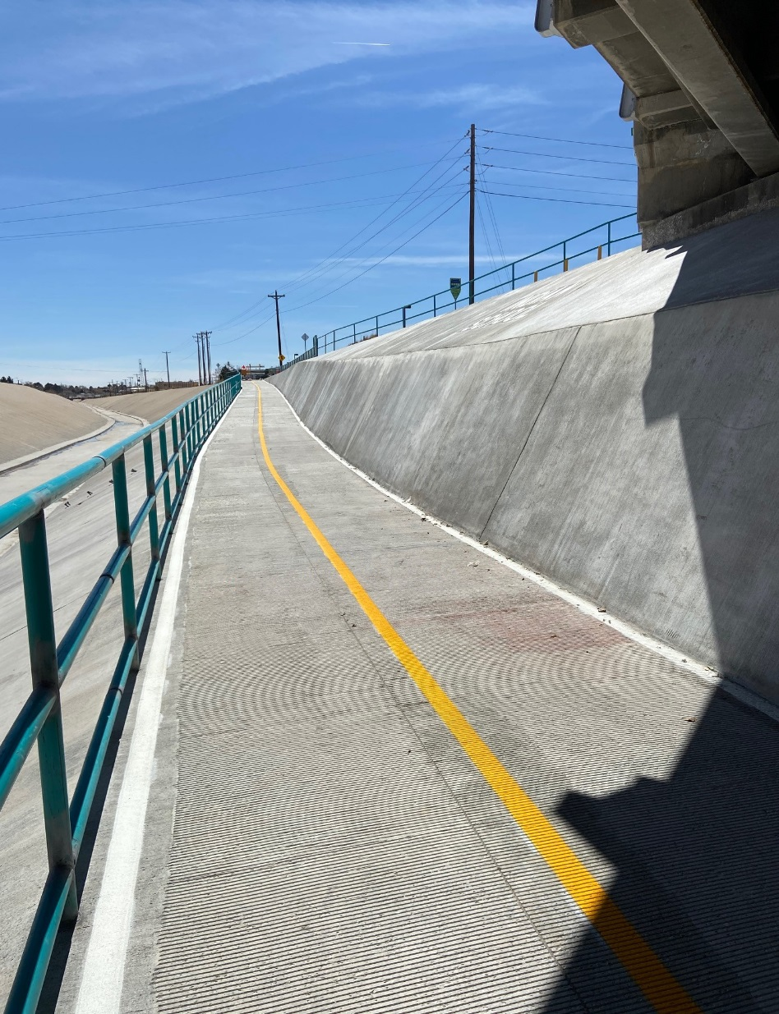
North Diversion Channel Undercrossing at Indian School

Slide 8
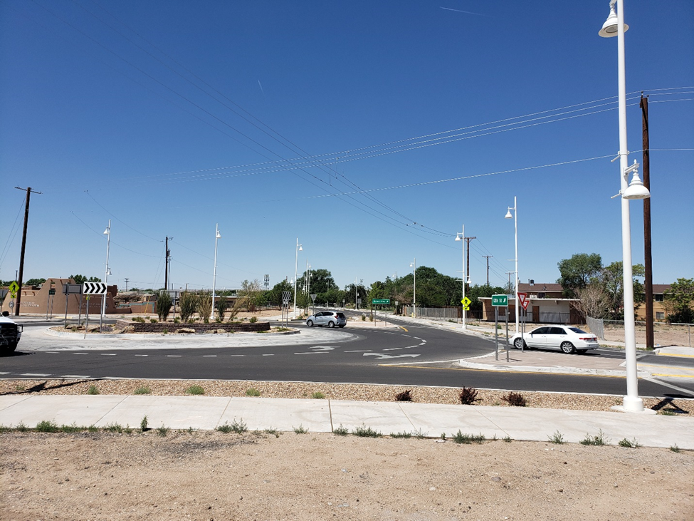
12th and Menaul Roundabout

Slide 9
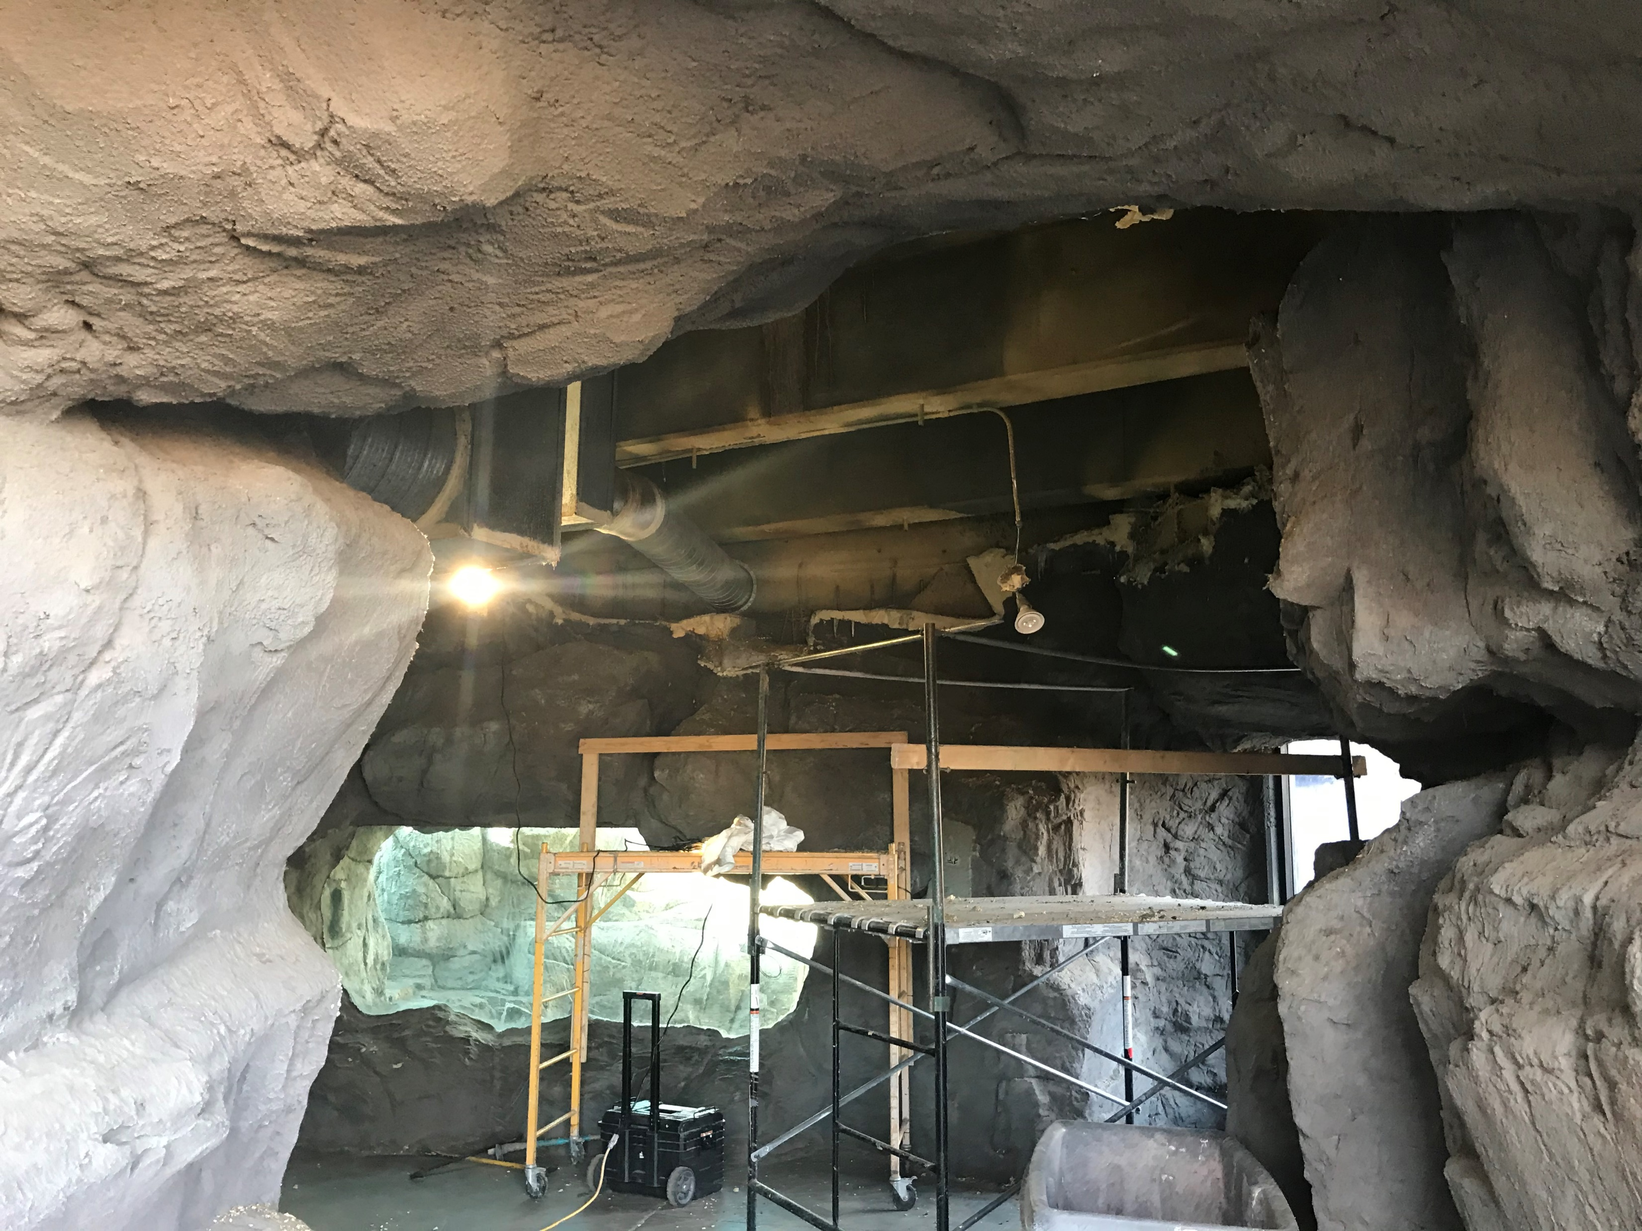
BioPark Polar Bear Tunnel Demo

Slide 10
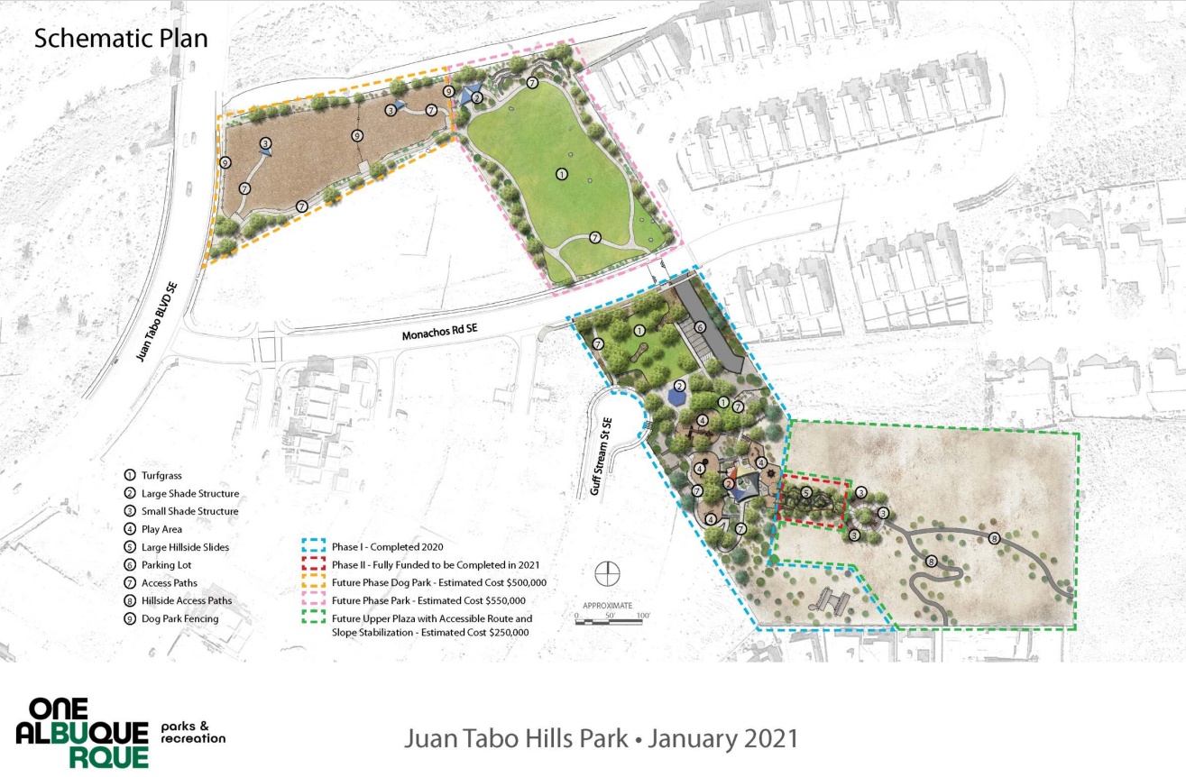
Juan Tabo Hills Park

Slide 11
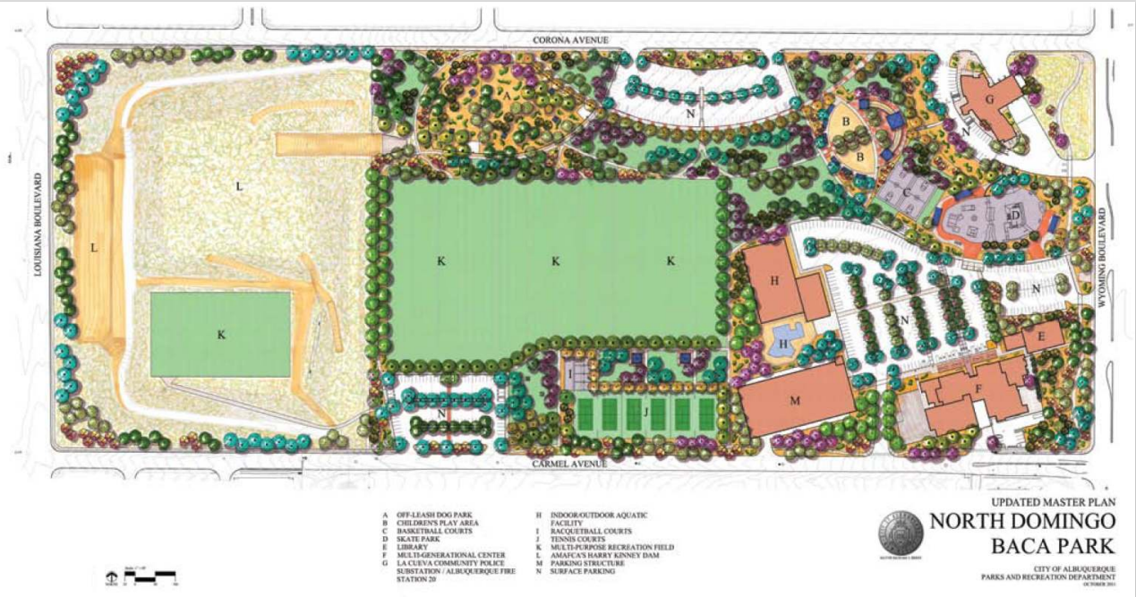
North Domingo Baca Park

Slide 12
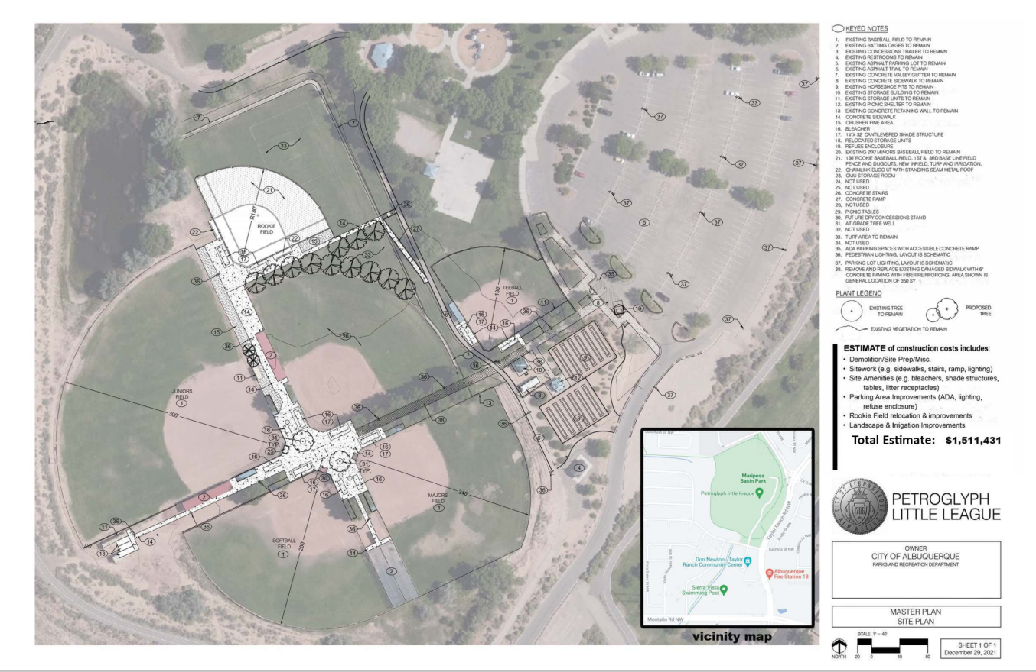
Petroglyph Little League

Slide 13
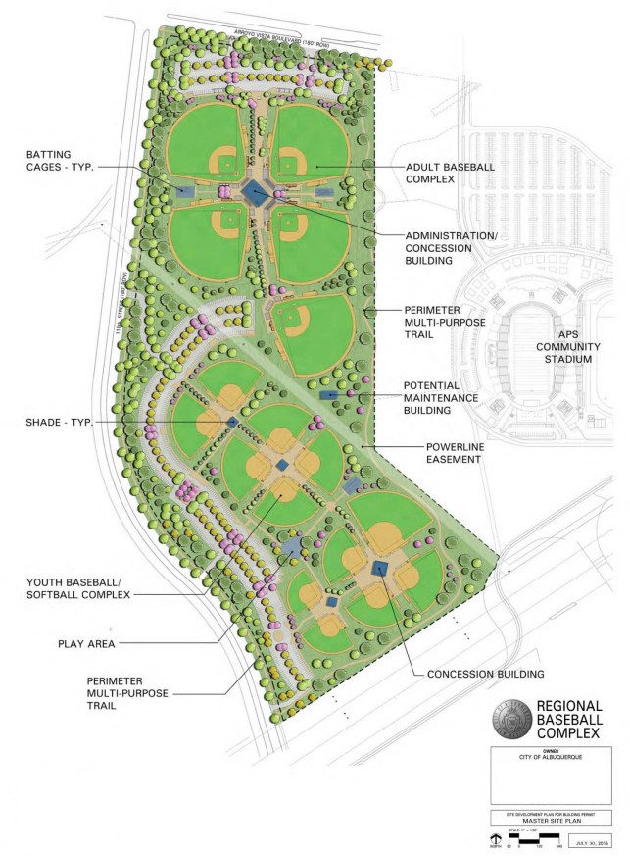
Regional Baseball Complex

Slide 14
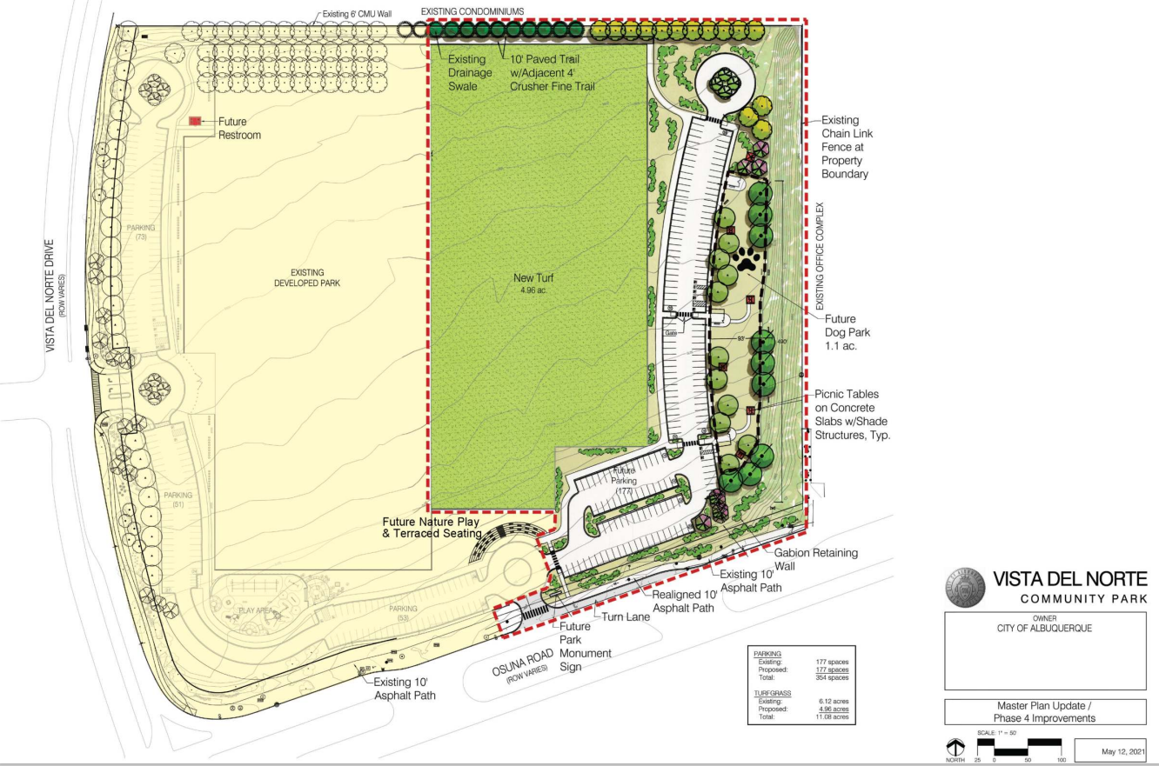
Vista Del Norte Community Park

Slide 15
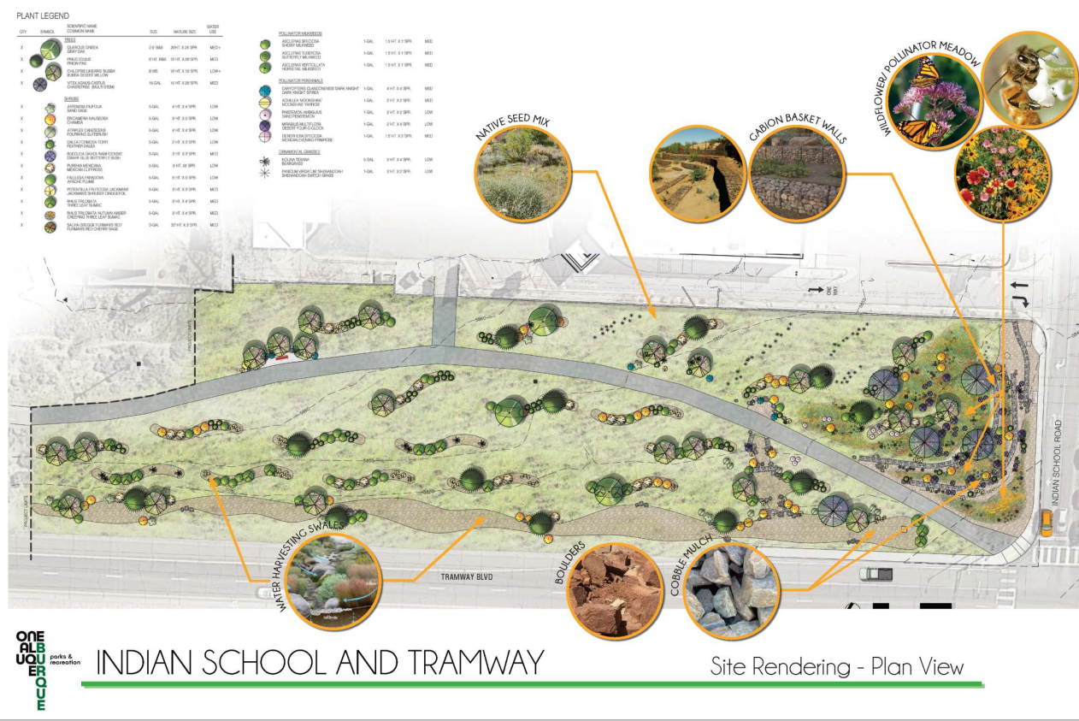
Indian School & Tramway

Slide 16
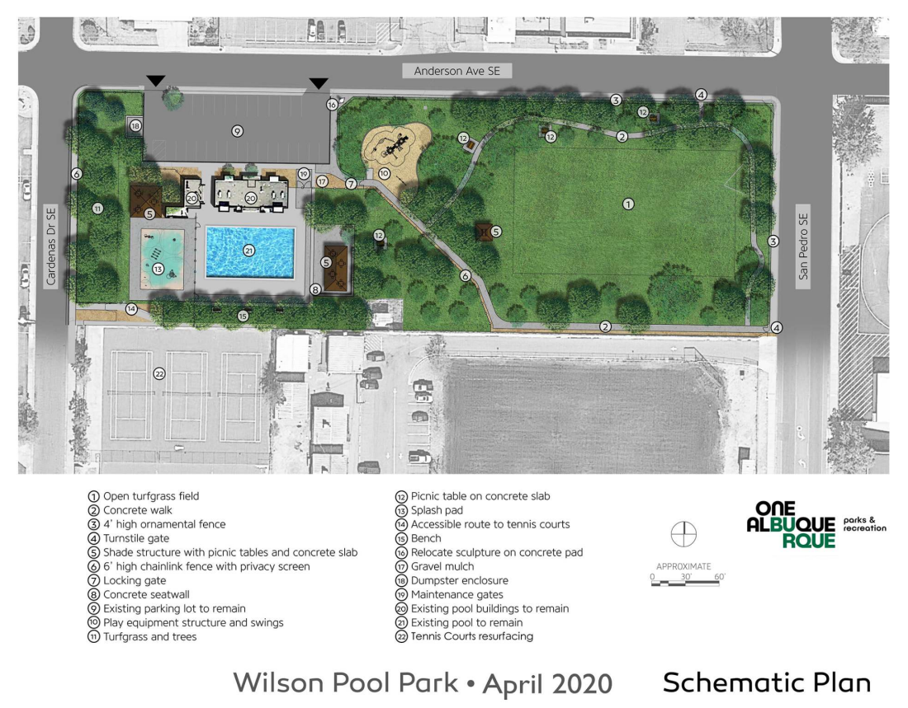
Wilson Pool Park

Slide 17
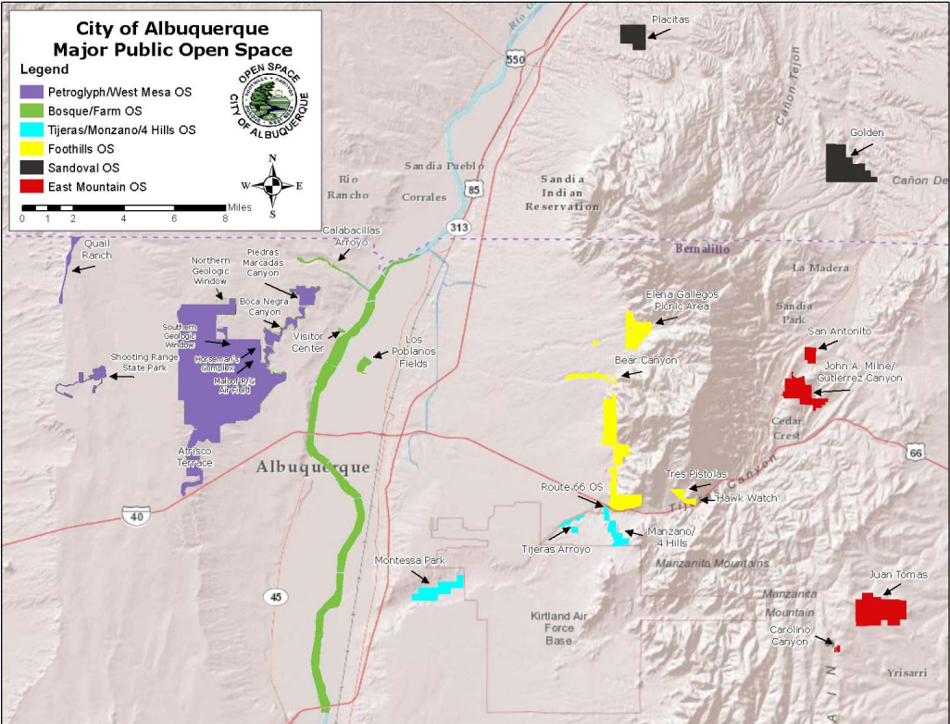
CABQ Major Open Space

Slide 18
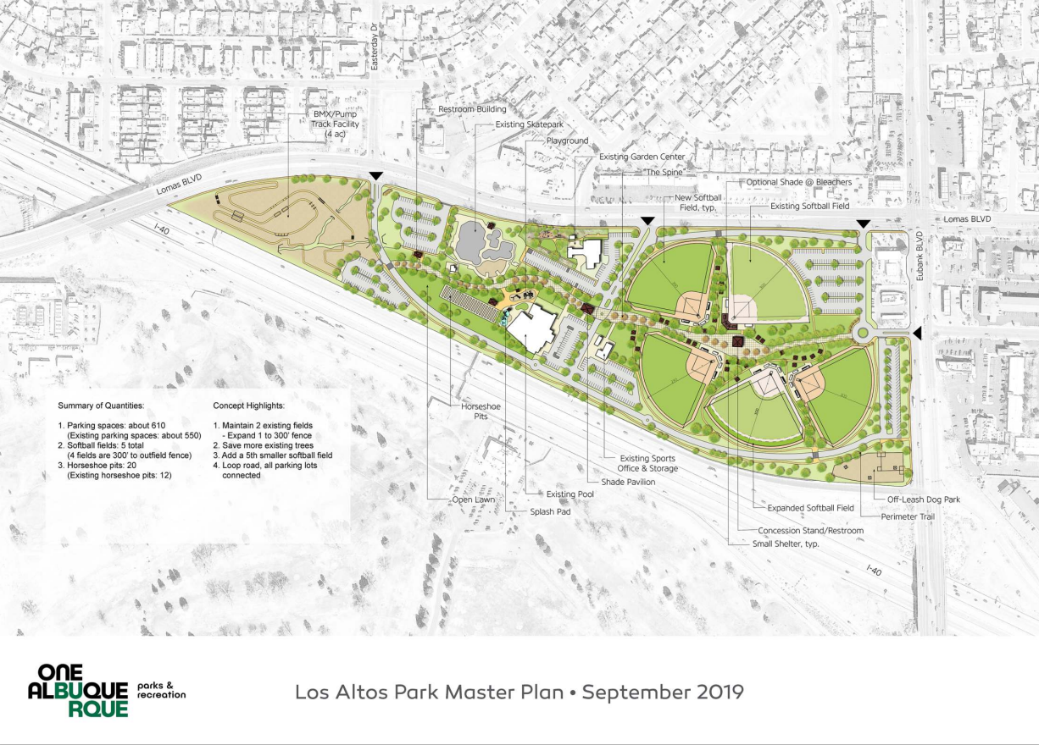
Los Altos Park

Slide 19
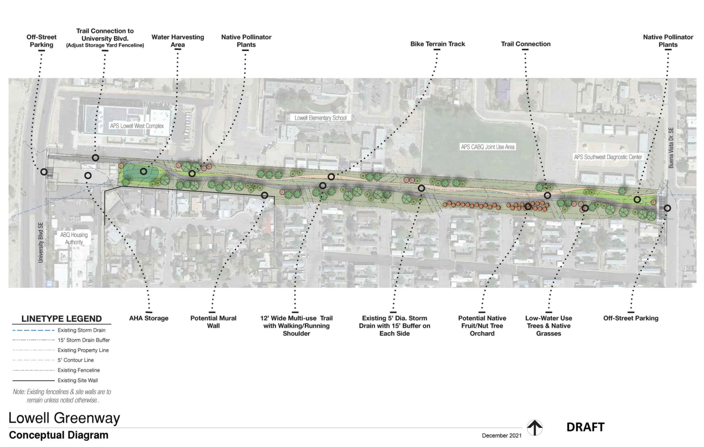
Lowell Greenway

Slide 20
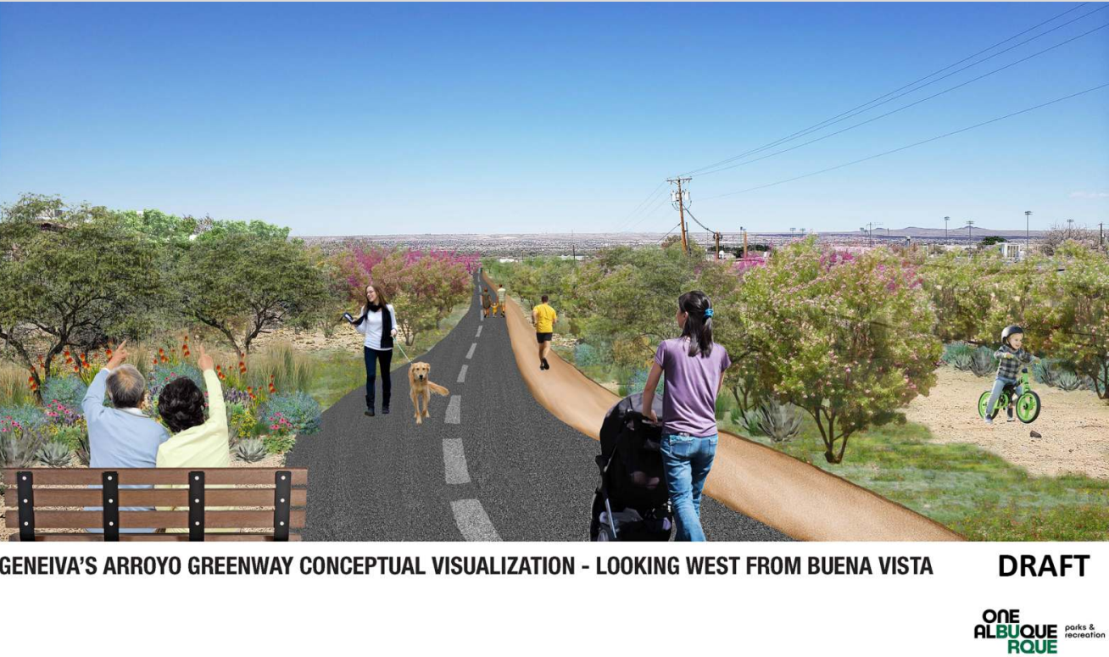
Geneiva’s Arroyo Greenway

Slide 21
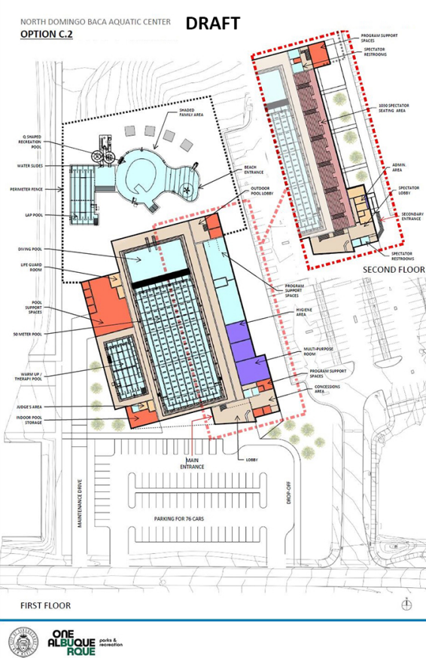
North Domingo Baca Aquatics

Slide 22
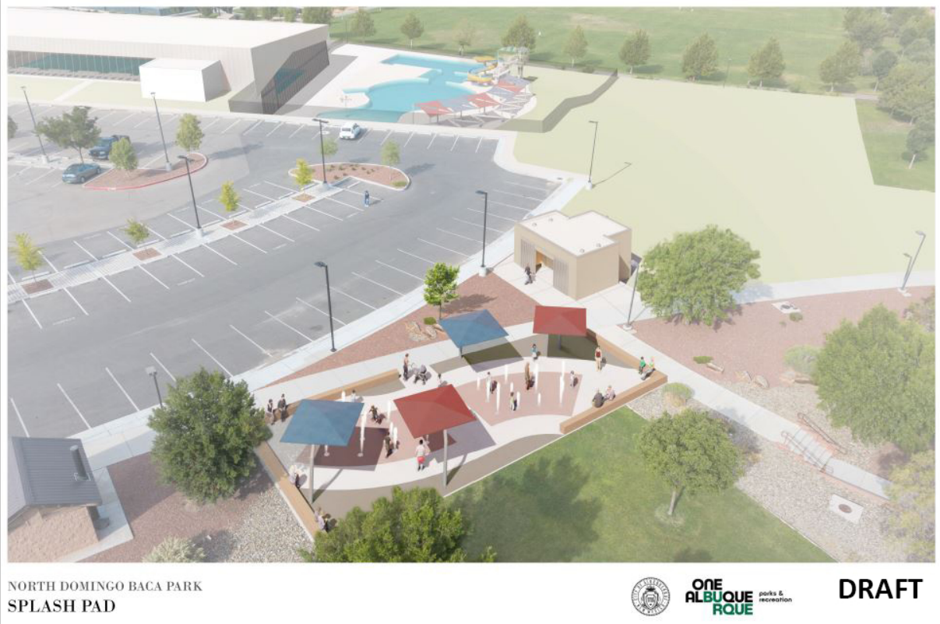
North Domingo Baca Splash Pad

Slide 23
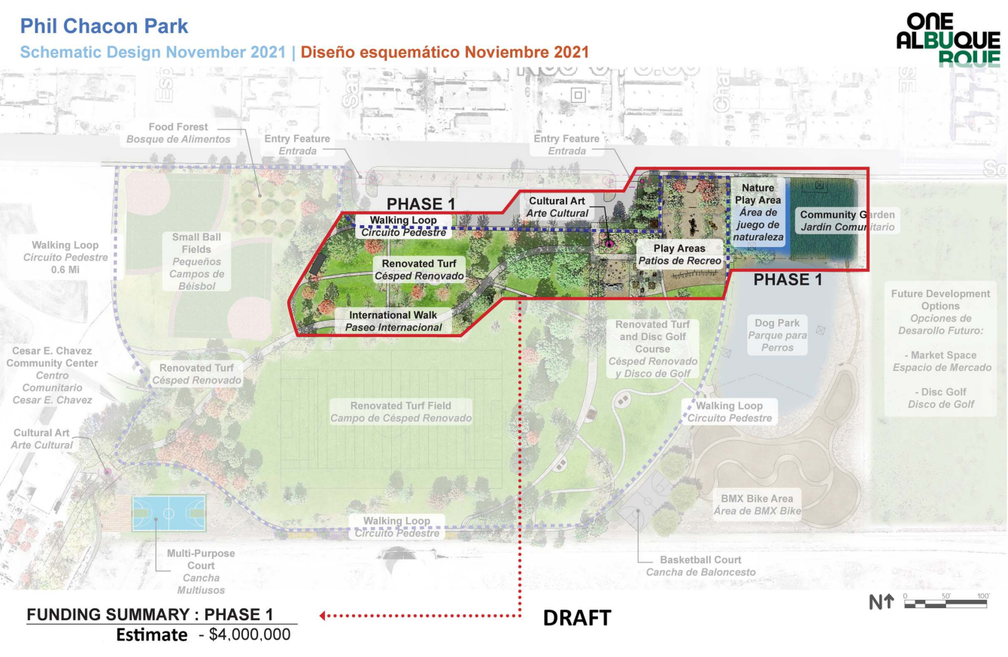
Phil Chacon Park

Slide 24
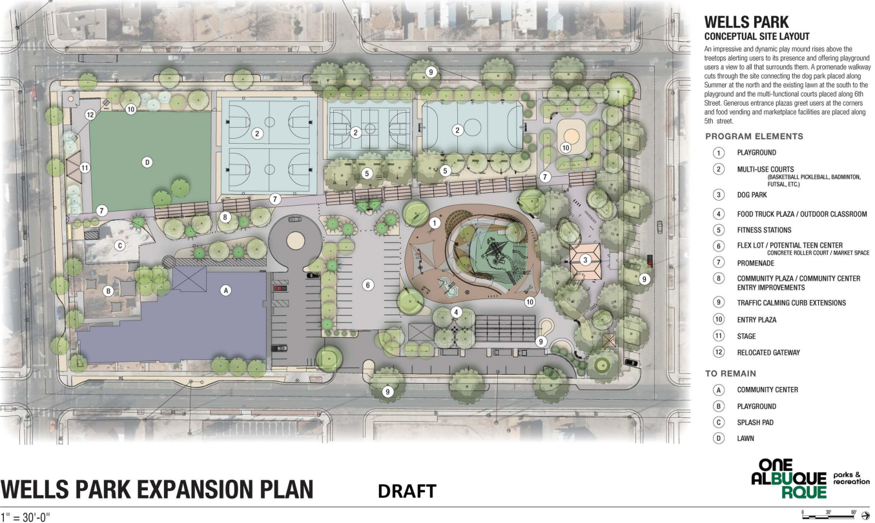
Wells Park

